Slide 1

SOFTWARE ENGINEERING
Week 6
Analysis Model

Slide 2
Agenda
Requirements Analysis
Structured Analysis
Data Model: Database objects and relations
Functional Model: Data flow
Behavioural Model: Control flow, Events and states

Slide 3

Requirements Analysis
Requirements Analysis
Structured Analysis
Data Model
Functional Model
Behavioural Model

Slide 4
Analysis and Design Approaches
Structured Analysis and Design
Data / Control
Flow Diagrams,
(DFD / CFD)
Object-Oriented Analysis and Design
Unified Modeling Language
Diagrams (UML)

Slide 5
Elements of Analysis Model
The Statement of Software Scope provides the basis for analysis modelling.
The following models are built during analysis:
Data model: Database objects and relations
Functional model: Data flow
Behavioural model: Control flow, Events and states

Slide 6
Modeling the Data Domain
Define data objects
Establish data relationships
Specify data content

Slide 7
Modelling the Functions
Basic Idea:
Software transforms data
To achieve this it must perform at least three generic functions: input, processing, output
Identify functions that transform data objects
Begin with a context level diagram (level 0)
Continue with more functional details in refined levels until all system functionality is represented

Slide 8
Modeling the Behaviour
Basic Idea:
Most software responds to events from the outside world
This characteristic forms the basis of the behavioral model
A computer program always exists in some state: an externally observable mode of behaviour (e.g. waiting, computing, printing, polling) that is changed only when some event occurs
Indicate different states of the system
Specify events that cause the system to change state

Slide 9
Structural Analysis
Requirements Analysis
Structured Analysis
Data Model
Functional Model
Behavioural Model

Slide 10
The Data Model
Requirements Analysis
Structured Analysis
Data Model
Functional Model
Behavioural Model

Slide 11
The Data Model
Data modelling is also called Database Modelling.
In data modelling, Entity-Relationship Diagrams are used.
Also a data dictionary is defined for important data items.
Entity Symbols (Bachman notation)
Relationship
Entity
Attribute

Slide 12
Relationship Symbols
A
B
One to one, mandatory
A
B
One to one, optional
A
B
One to many, mandatory
A
B
One to many, optional
Cardinality
Modality

Slide 13
Example: Students and Courses (Bachman notation)
ID Number
Code
Takes
Student
Course
First name
Last name
Name
Credits

Slide 14
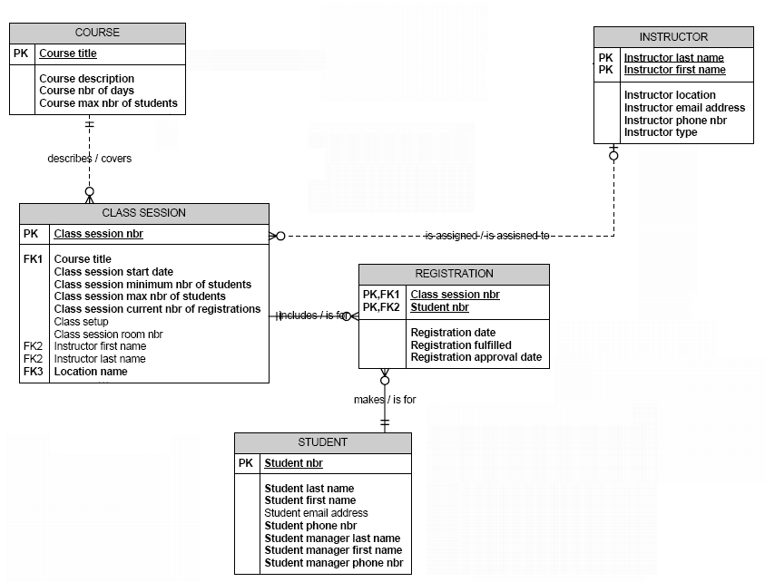
Example: Registration

Slide 15
Example : Orders
Name
Address
Order No
Order Date
Customer
Orders
Order
Contains
Item
Item Name
Price

Slide 16
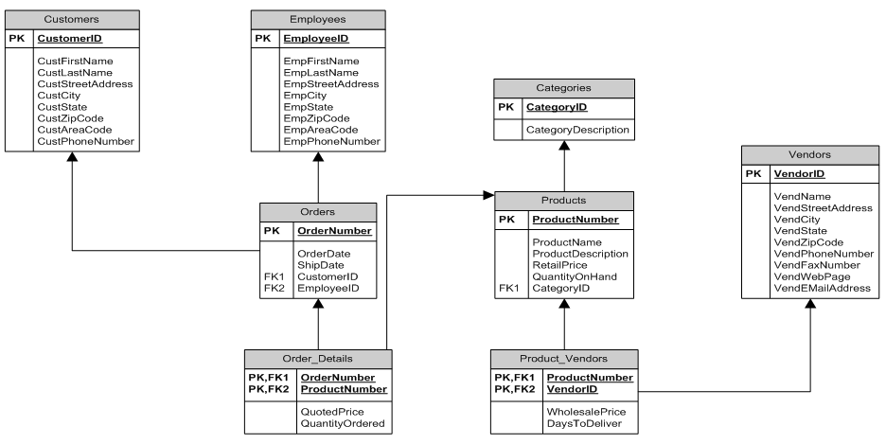
Example : Orders and Products

Slide 17
Data Dictionary
Data dictionary is a collection of data item definitions.
A data item is desribed with the followings:
Data Name | the primary name of the composite data item
Aliases | other names for the data item
Where used | data transforms (processes) that use the composite data item
How used | the role of the data item (input, output, temporary storage, etc.)
Description | a notation for representing content
Format | specific information about data types, default values (if known)

Slide 18
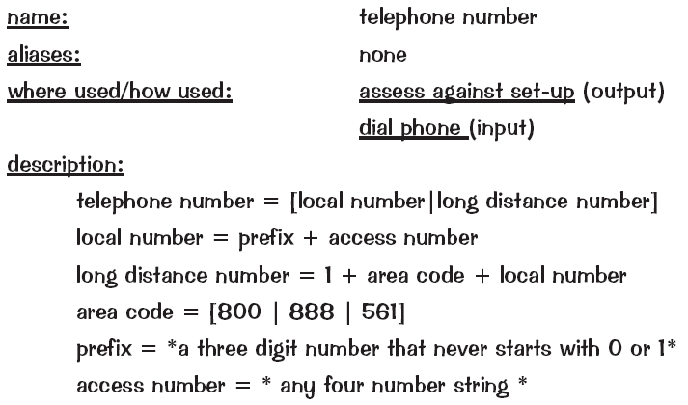
Data Dictionary Example

Slide 19
Data Dictionary Example
İTÜ Student ID = 04 – 009 - 0761
Electrical-Electronics faculty
Entrance year
Order number

Slide 20

The Functional Model
Requirements Analysis
Structured Analysis
Data Model
Functional Model
Behavioural Model

Slide 21
The Functional Model
Functional modelling is also called Process Modelling.
In functional modelling, Data Flow Diagrams are used.
There are various DFD notations such as:
Yourdon & Coad notation
Gane & Sarson notation
For details of a process one of the followings can be used:
Flow Chart
Program Description Language (i.e. pseudocode)

Slide 22
Yourdon & Coad notation for DFD
process
data flow
external entity
data store

Slide 23
Gane & Sarson notation for DFD
Double
square
Source or destination of data
arrow
Flow of data
Rounded
rectangle
Process that transforms a flow of data
Open-ended rectangle
Store of data

Slide 24
External Entity
external entity
A producer or consumer of data
Examples: a person, a device, a sensor
Another example: computer-based system
Data must always originate somewhere
and must always be sent to something

Slide 25
Process
A data transformer (changes input to output)
process
Examples: compute taxes, determine area,
format report, display graph
Data must always be processed in some
way to achieve system function

Slide 26
Data Flow
Data flows through a system, beginning
as input and be transformed into output.
base
compute
triangle
area
area
height

Slide 27
Data Stores
data store
Data is often stored for later use.
sensor #
sensor #, type,
location, age
look-up
sensor
data
report required
type,
location, age
sensor number
sensor data

Slide 28
Example: Generic DFD
Process1
External Entity1
Process2
Data Store1
Data Store2
Process3
External Entity2

Slide 29
DFD Rules (1)
External
Agent
External
Agent

Slide 30
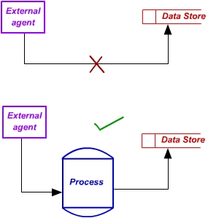
DFD Rules (2)

Slide 31
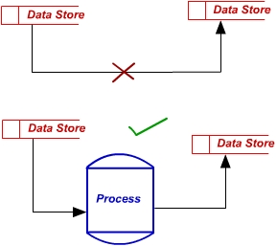
DFD Rules (3)

Slide 32
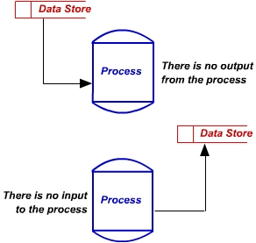
DFD Rules (4)

Slide 33
Data Flow Refinement
DFD modelling is performed from level-0 to level-1, level-2, etc.
A suggested expansion ratio between one level and the next level is 1:5
Most systems require between 3 and 7 levels for an adequate flow model
If a bubble does a number of different things, it needs further refinement.
Each bubble is refined until it does just one thing
The expansion ratio decreases as the number of levels increase

Slide 34
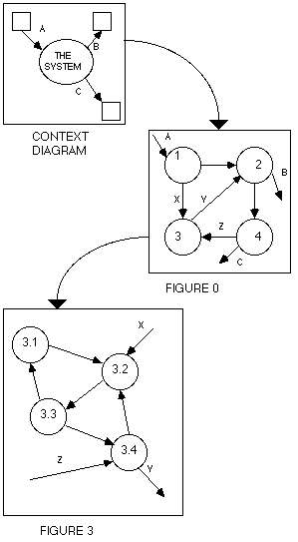
Example of Data Flow Refinement
refine
refine
34

Slide 35
Example Data Flow Hierarchy
level 0
a
b
x
P
y
a
c
p2
f
p1
level 1
p4
b
d
p5
p3
e
g

Slide 36
Example: DFD for Quizzing Software
Generate
Quiz
quiz
number
Question-Bank
questions
question text
Student
choose
answer
Record
Answers
answers
Student Answers
student
answers
Score results :
correct/
incorrect
Evaluate
Answers
correct
answers
Correct Answers

Slide 37
Example: DFD for Employees

Slide 38
Example: DFD for Courses
Offered course
1.Schedule
course
Academic
department
Enrollment
request
2.Enroll
student
Student
Offered courses
Schedule
Course enrollment
Student
3.Produce
Class list
Teacher
Class list

Slide 39
DFDs: A Look Ahead
Maps into
Analysis model
Design model

Slide 40
The Behavioural Model
Requirements Analysis
Structured Analysis
Data Model
Functional Model
Behavioural Model

Slide 41
The Behavioural Model
In behavioural modelling, Control Flow Diagrams and State Transition Diagrams are used.
Control Flow Diagrams is mostly used in Embedded or Real-time software development.
The control flow diagram is superimposed on the DFD and shows events that control the processes noted in the DFD.
Control flows (events and control items) are noted by dashed arrows.

Slide 42
Control Flow Diagrams
Represents “events” and the processes that manage events
An “event” is a Boolean condition that can be ascertained by:
listing all sensors that are "read" by the software.
listing all interrupt conditions.
listing all "switches" that are actuated by an operator.
listing all data conditions.
Examining the processing narrative, review all "control items" as possible CSPEC inputs/outputs.
A CSPEC is shown with a State Transition Diagram.

Slide 43
Control Flow Diagrams
a dashed arrow entering a vertical bar is an input
a dashed arrow leaving a process implies a data condition
a dashed arrow entering a process implies a control input read directly by the process

Slide 44
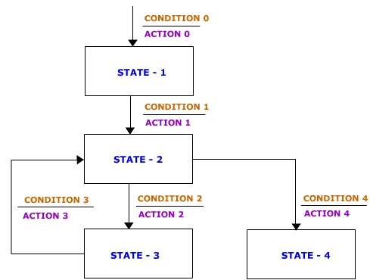
State Transition Diagrams
STD can be used to model the state changes of the system.
A system is in a state and will remain in that state till a condition and an action force it to change state.

Slide 45
Example:
Vending Machines
Management Software

Slide 46
Statement of Software Scope (1)
You’ve been asked to develop a management software for a company which maintains a large number of vending machines (self-service machines to sell snack foods).
Vending machines are at several locations across the city.
Each location can have one or more machines.
Vending machines need to be refilled with different quantities depending on the consumption at each location.

Slide 47
Statement of Software Scope (2)
Each location is served by one service personnel.
All foods are stored in the company’s warehouse.
Before a personnel leaves for servicing, he requests foods from the warehouse for refilling.
After returning from servicing, the service personnel submits the cash he collected from each machine to the company; returns any unused foods; and informs the company of any problems with the machines.
When the food stock gets low, a purchase order is generated.

Slide 48
Statement of Software Scope (3)
The company wants to manage their business using the software that keeps track of the
locations,
machines,
service personnel,
food stocks,
maintenance history for machines,
the amount of food requested and returned by each personnel,
total cash generated per machine, per location,
details of any purchase orders generated.
Daily reports (such as total cash report, maintenance summary report, purchase order) will need to be generated.

Slide 49


System Outline
Location 1
Location 2
Warehouse
machine 1
machine 2
machine 1
machine 2
machine 3
food 1
food 2
food 3
. . .
Service
person 2
Service person 1

Slide 50
Tasks
Draw an Entity Relationship Diagram that describes the relationships between the different data entities.
For each relationship, name the relationship and define its cardinality (1-1, 1-n, or n-m).
For each entity, list all data items.
Produce Level-0 and Level-1 Data Flow Diagrams that captures the main processes, data flows, information sources and data stores of this application.
Produce a Program Structure Chart.

Slide 51
Entity Relationship Diagram (ERD)

Slide 52
Entities
ENTITIY | DATA ITEMS
Locations | Location_ID, Address, Number of consumers, ServicePersonnel_ID
Machines | Machine_ID, Location_ID, Frequency of refilling
Personnels | Personnel_ID, Personnel name
Stocks | Food_ID, Food name, Current amount
Food_Requests | Personnel_ID, Food_ID, Date of request, Amount of request, Returned amount
Cash_Collection_History | Machine_ID, Date of collection, Amount of cash
Maitenance_History | Machine_ID, Date of maintenance, Type of maintenance
Purchase_Orders | Order_ID, Food_ID, Date of order, Amount of order

Slide 53
Level-0 DFD
Personnels
Cash History
User
Maintenance History
Management
Software
Stocks
Display
Screen
Orders
Food requests
Locations
Machines

Slide 54
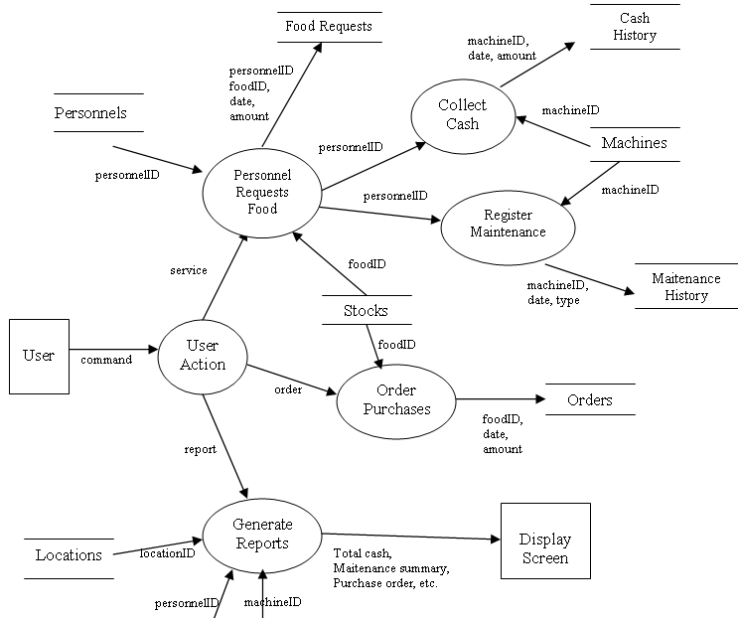
Level-1 DFD

Slide 55
Isolating the flows in Level-1 DFD
P2
P1
P3
P4

Slide 56
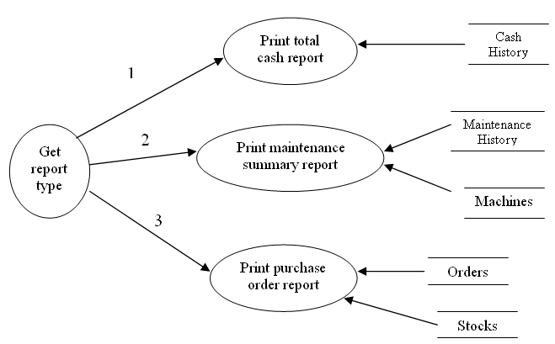
Level-2 DFD for P4

Slide 57
Program Structure Chart
Getting User
Action Choice
Requesting and Servicing Food
Ordering
Purchases
Generating
Reports
Collecting
Cash
Registrating
Maintenance History
Total Cash
Report
Maintenance Summary
Purchase Order

Slide 58
Example:
Technical Service
Management Software

Slide 59
Statement of Software Scope (1)
A technical service firm needs a web-based software to keep track of maintenance and repairment operations for their customers’ devices such as combi, air conditioner, laundry machine, refrigerator, etc.
The followings are functional requirements:
A “Service Request Form” must be filled for all kinds of service requests. The form must contain fields for customer name, address, telephone, and a description of service being requested.

Slide 60
Statement of Software Scope (2)
The request will be tracked by a status code:
“Device will be picked up from customer”
“Device will be serviced at customer’s place”
“Device is in service”
“Device waiting for delivery to customer”
“Delivery completed”
A request can be done directly by a customer over the Internet, or an authorized personnel can record the request for the customer.
Customer should be able to query the status of his service request.

Slide 61
Statement of Software Scope (3)
The manager will assign a service request task to an available technician.
For each service request the followings should be recorded: Device information (device type, brand, model, warranty status, start date, expiration date); Jobs done at service, Spare parts used if any, Billing amount (TL).
For customers who has warranty agreement, periodic maintainances will be tracked. For this purpose, a list of devices which are sorted by warranty expiration date should be available.

Slide 62
Statement of Software Scope (4)
“Service Request Lists” should be available with different criteria:
by service registration number
by customer name
by status code
by device type
by request type
by date of request
by technician name

Slide 63
Entity Relationship Diagram (ERD)
CUSTOMERS
Customer Number
Customer Name
Customer Telephone
Customer Address
TECHNICIANS
Technician Number
Technician Name
1
1
SERVICE-REQUESTS
Customer Number
Service Registration Number
Date of Request
Request Type
Request Description
Assigned Technician Number
Status Code of Request
Device Type
Device Brand
Device Model
Device Warranty Status
Device Warranty Start Date
Device Warranty Expiration Date
Jobs Done at Service
Spare Parts Used
Billing Amount (TL)
n
m

Slide 64
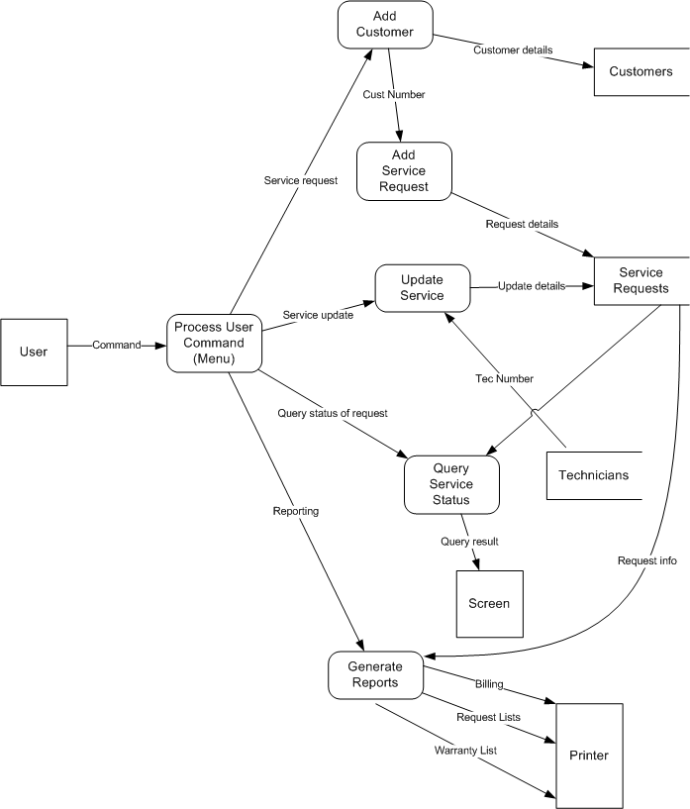
Level-1 DFD

Slide 65
Program Structure Chart

Slide 66
Wrap-up
This week we present
Structural Analysis: Where the main focus of the analysis stage is handling static and dynamic system behaviour separately
Object Oriented Analysis: Where the main focus of the analysis is to represent the objects inherent in the requirements as classes with specific data and behaviour

Slide 67
Next Week
We will be covering Architectural Models and Model Driven Engineering!!!

